Slide 1



Customer Insights for Hygiene Services
A Strategic Consulting Project
FLICK PEST CONTROL

Slide 2
Meet the Team
JOSH MITELMAN
Project Oversight · Data Analysis · Team Coordination
TRUONG NGUYEN
External Liaison · Industry Research · Communication
SHU MIN PUAH
Marketing Strategy · Team Communication · Visual Design
XILIN HUANG
Finance Research · Cost Analysis · Financial Insights
“We bring together skills in finance, analytics, communication, and strategy to deliver value to our client.”

Slide 3

Today’s
Structure
Presentation Overview
1
Introduction
2
Problem Statement
3
Project Approach
4
Key Findings & Recommendations

Slide 4


About Flick Pest Control
Flick is a leading pest control and hygiene service provider in Australia.
Established in 1918, with over 100 years of industry experience.
Now part of the global Anticimex Group, operating across 50+ branches in Australia.
Over 1,250 staff servicing more than 300,000 customer sites annually.
General Pest Control
Residential Services
Key Serivce Areas
Termite Solutions
Hygiene

Slide 5
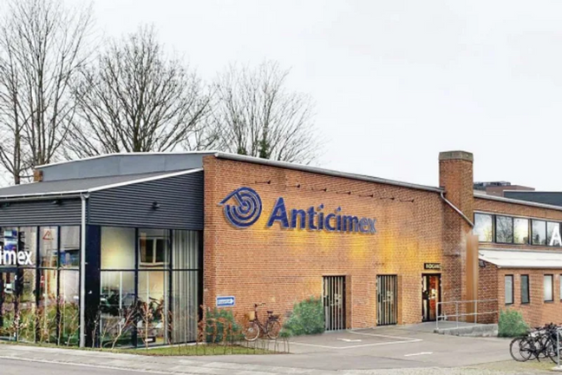
Project
Current
Purpose 🎯
Challenges ❓
To support Flick’s Hygiene division in understanding its current customer base and improving resource allocation and marketing strategies.
Flick seeks to gain greater visibility into customer behaviour and service patterns to make more data-informed business decisions.
Final
Deliverables 📦
Project
Brief & Scope
Data-driven customer insights.
Strategic recommendations for marketing and resource deployment.

Slide 6

Key Components of
Customer Insights
Customer Industry Segmentation
Service Types
Customer Industry Segmentation:
Identify industries with strong growth potential and opportunities for long-term investment.
Service Types:
Product/service demand & preferences among customers.
Analytical Focus Areas
🔍
Service Frequency:
Customer engagement levels & service intensity.
Revenue Contribution:
Pinpoint high-value clients & prioritise retention and upselling strategies.
Service Frequency
Revenue Contribution
Project Brief & Scope

Slide 7

Overview Of The Issue
Flick Pest Control operates in a competitive pest control and hygiene services industry. Despite its strong market presence, limited insight into its hygiene customer base is hindering its ability to:
Tailor marketing campaigns effectively
Identify high-value customer segments
Allocate marketing and operational resources optimally

Slide 8




Specific Problem in the Hygiene Sector
The hygiene service segment serves diverse industries (e.g., hospitality, education, property management)
There is insufficient segmentation of hygiene customers by revenue, size, industry, and service frequency.
Customer retention rates in this sector are not clearly tracked or understood.
Marketing strategies are not clearly aligned with actual customer needs and behaviors in the hygiene domain.
Competitive positioning for hygiene services remains unclear — especially compared to rival firms offering bundled or tech-enhanced hygiene solutions.

Slide 9
Scope Of Work
Customer Data Analysis
Behavioral and Retention Patterns
Strategic insights and reccomendations
Break down hygiene service customers by:
Industry sector.
Business size (revenue, sites, employees).
Geographic location.
Tenure with Flick.
Revenue contribution and service mix.
Identify:
Most commonly used hygiene services.
Customer longevity patterns.
Key factors contributing to retention or churn.
Highlight potential growth opportunities.
Recommend how Flick can:
Improve marketing effectiveness.
Optimize customer targeting.
Boost retention in high-value segments.

Slide 10


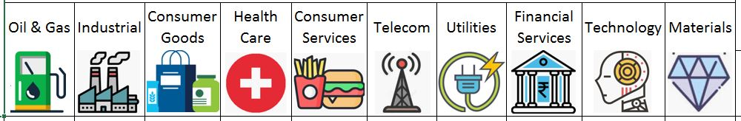

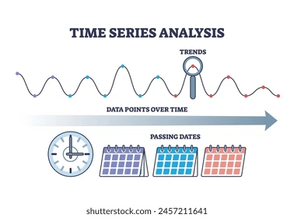
Project Approach
Quantitative Analysis
Data Driven
Split into Service Industry and Type
Time Series Trends
Microsoft Excel and R language

Slide 11
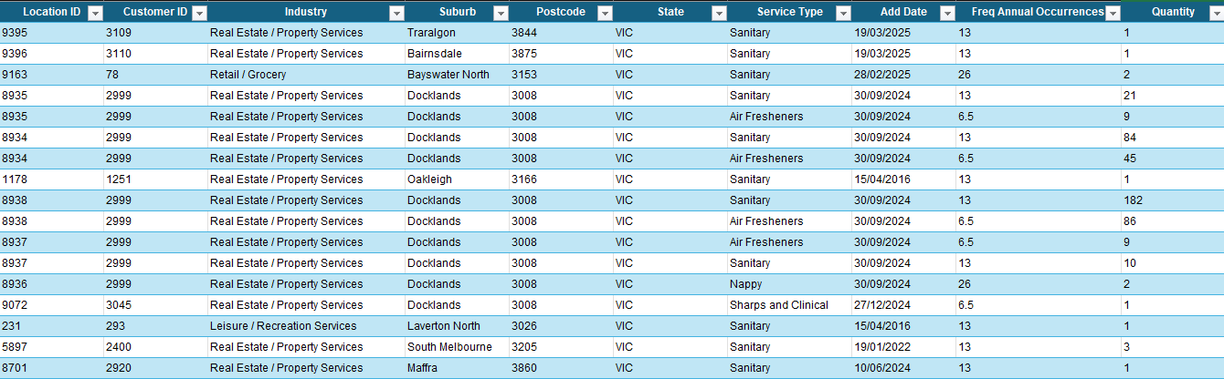
The
Data
Each row represents one registered ongoing Flick hygene service
Customer ID - the ID of the organisation the service is for. A customer can have multiple services and locations.
Location ID - the ID for the location where the service take’s place. A location relates to one specific customer but can have multiple services.
Service type - represents which of Flick’s hygene services a service relates to
Add Date - the date at which the service was registered/commenced
Industry - the industry the customer/location of the service belongs to
Frequency of Annual Occurences - how many times the service is performed every year
Quantity - the number of units serviced during each occurence.
Adjusted Average revenue (not shown above) - an approximate value for the revenue the service generated this year

Slide 12
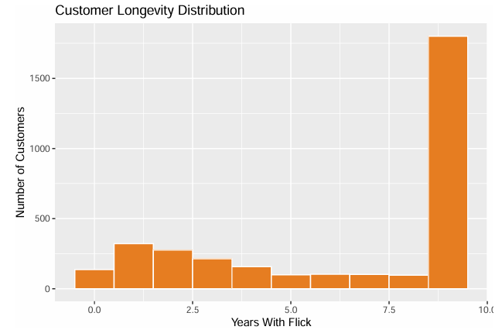
Environmental Cleaning and Disinfection
Hand
Hygiene
Personal Protective Equipment
Key Findings
Customer Longevity
Vast majority of customers have been with Flick for over 8 years
High loyalty of much older customers
Low amount of new customers suggests difficulty attracting and/or retaining new customers
Respiratory Hygiene and Cough Etiquette
Isolation Precautions
Vaccination Programs
Surveillance and Monitoring
Healthcare Worker Health Programs
Education and Training

Slide 13
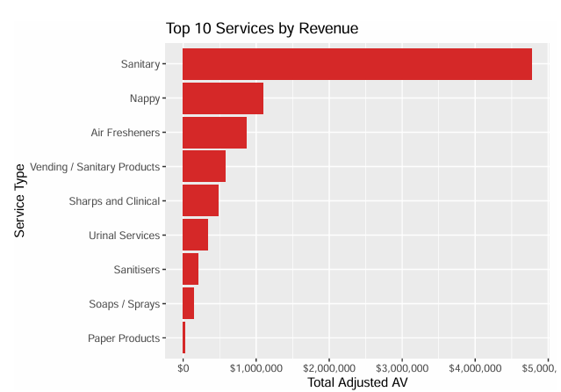
Key Findings
Revenue of Services
Sanitary dominates as Flick’s most profitable hygene service
Could be due being both their most high demand and most expensive service
Possible room for growth in more prominent services other than Sanitary, such as Nappy, Air Fresheners and Vending

Slide 14
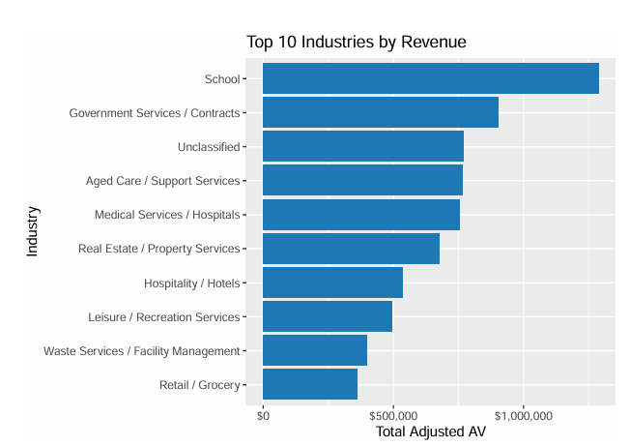
Key Findings
Industry Profitability
More balanced proportions when splitting revenue by industry compared to service type
Schools are the industry that brings Flick the most revenue
~$750k of revenue from Unclassified industry sectors
When considering the previous chart, it is likely that all of these industries use Flick’s Sanitary service

Slide 15
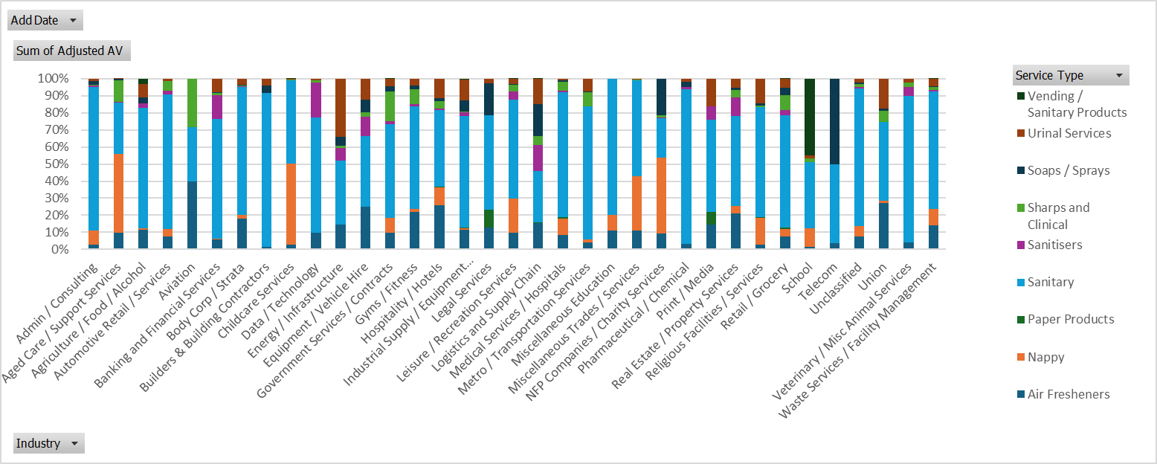
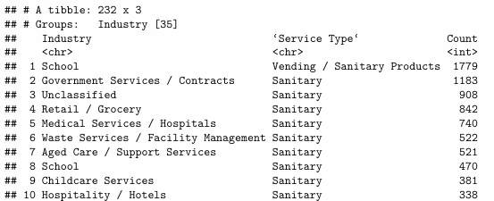
Key Findings
Proportion of Revenue by Service Type per Industry
Majority of industries have Sanitary as their highest proportion service type
Schools (Flick’s largest revenue industry for hygene) have a uniquely high proportion of Vending services
Nappy and/or Air Fresheners services also make up a large proportion of Flick’s revenue in each industry

Slide 16
Key Findings
Next Steps for Future Analysis
Recommendations
Analysis of trends over time using Add Date field
Focus on improving strategies to draw in new customers and their retention, such as with loyalty programs
Explore opportunities to grow Nappy, Air Freshener and Vending services rather than relying on Sanitary services for a majority of revenue
Expanding Vending services in the Schools industry sector as their largest current source of revenue
Analysis of site location using State and Postcode fields
Further analysis of Customer Longevity by Industry
Further analysis of trends over time by Service Type

Slide 17
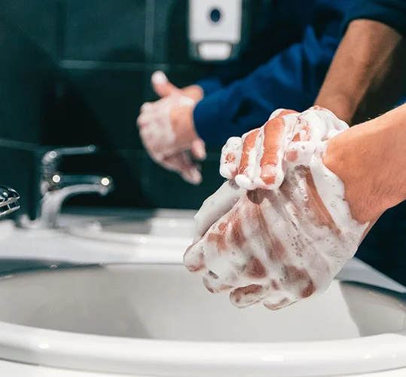
Thank You!
Questions?

